Slide 1
Tropical Layer Robustness Implemented in Convolutional Neural Network
Updated: 4/5/2023

Slide 2
Experiment Methodology
Train model
Attack test set using model with the projected gradient descent attack method
Evaluate model on test set before and after attack

Slide 3
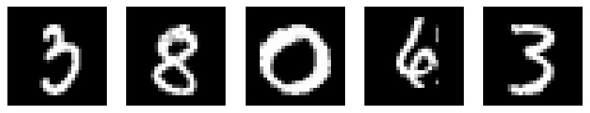
Data Used
MNIST – Simple handwriting Data
Numbers 0-9
Data is shaped 28x28x1 (1=grayscale and not RGB)
Train set = 60,000 images
Test set = 10,000 images

Slide 4
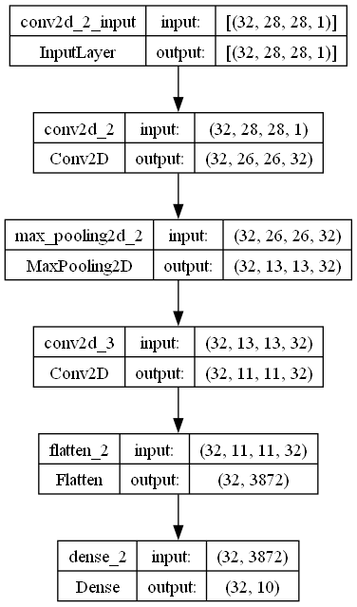
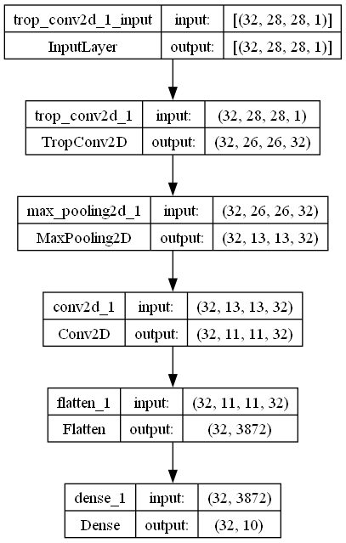
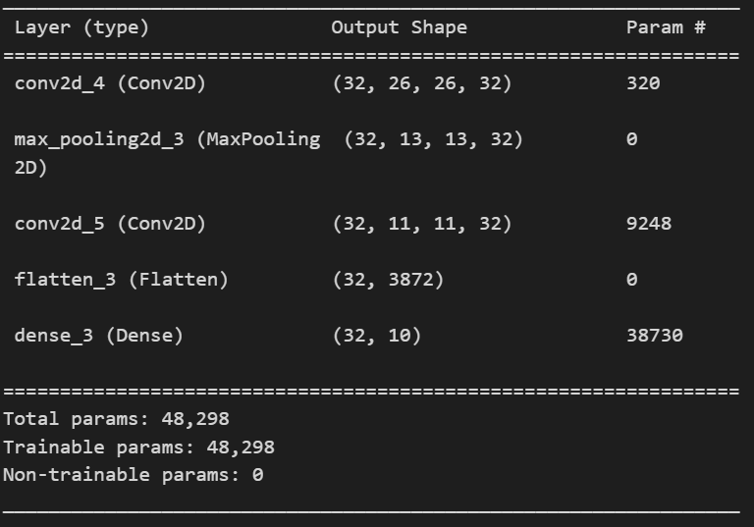
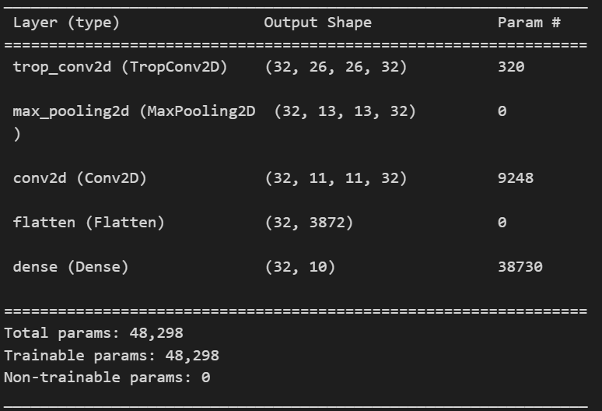
Models Used (yellow=difference)
Benchmark model (2 ReLu Convolutions)
Our model (1 Tropical Convolution, 1 ReLU convolution)
Model Graph
Model Summary
Model Graph
Model Summary

Slide 5
Tropical Convolutional Layer Code
class TropConv2D(Layer):
def __init__(self, filters = 64,
window_size = [1, 3, 3, 1],
strides = [1, 1, 1, 1],
rates = [1, 1, 1, 1],
padding = 'VALID',
initializer_w = initializers.random_normal,
lam = 0.01):
super(TropConv2D, self).__init__()
self.filters = filters
self.initializer_w = initializer_w
self.window_size = window_size
self.strides = strides
self.rates = rates
self.padding = padding
self.lam = lam
def build(self, input_shape):
channels = input_shape[-1] # Extract the last dimension from input_shape
self.w = self.add_weight(shape=(1, 1, 1, self.window_size[1] * self.window_size[2] * channels, self.filters),
initializer=self.initializer_w,
regularizer=TropReg(lam=self.lam),
trainable=True)
self.bias = self.add_weight(name='bias',
shape=(self.filters,),
initializer="zeros",
trainable=True)
super(TropConv2D, self).build(input_shape)
def call(self, x):
x_patches = extract_patches(images=x, sizes=self.window_size, strides=self.strides, rates=self.rates, padding=self.padding)
result_addition = expand_dims(x_patches, axis=-1) + self.w
return reduce_max(result_addition, axis=(3)) - reduce_min(result_addition, axis=(3)) + self.bias

Slide 6
Tropical Convolution and Activation
def call(self, x):
x_patches = extract_patches(images=x, sizes=self.window_size, strides=self.strides, rates=self.rates, padding=self.padding)
result_addition = expand_dims(x_patches, axis=-1) + self.w
return reduce_max(result_addition, axis=(3)) - reduce_min(result_addition, axis=(3)) + self.bias
x_patches defines our “windows” that each kernel/filter will be applied to for our output “feature map”. Takes a 4-D input and has a 4-D output.
If dimensions of our input are (batch, height, width, channels) then extract patches will make a map that is sized (batch, new_rows, new_columns, flattened_patch). In a 3x3x3 kernel/filter size then the flattened_patch will be 27 and correspond with our weights.
MNIST example, if we input data of shape (32, 28, 28, 1) with window sizes of 3x3 and stride length of 1 the output is of shape (32, 26, 26, 9)
result_addition adds our weight parameters across all x_patches windows. When we “expand_dims” this enables each of the kernel/filter to be added to each of the windows.
Our kernel/filter trainable weights are of shape (1, 1, 1, 9, 32)
Our bias term for each kernel/filter is of shape (32,) << I validated Tensorflow adds along correct dimension
MNIST example: result_addition = (32, 26, 26, 9, 1) + (1, 1, 1, 9, 32) = (32, 26, 26, 9, 32)
return reduce_max and reduce_min, allows us to get the max and min values along the weight axis, giving us our distances for each of the patches as they are projected onto our kernel/filter weights/tropical-hyperplanes.
MNIST example: return (32, 26, 26, 32) – (32, 26, 26, 32) + (1, 1, 1, 32) = (32, 26, 26, 32)

Slide 7
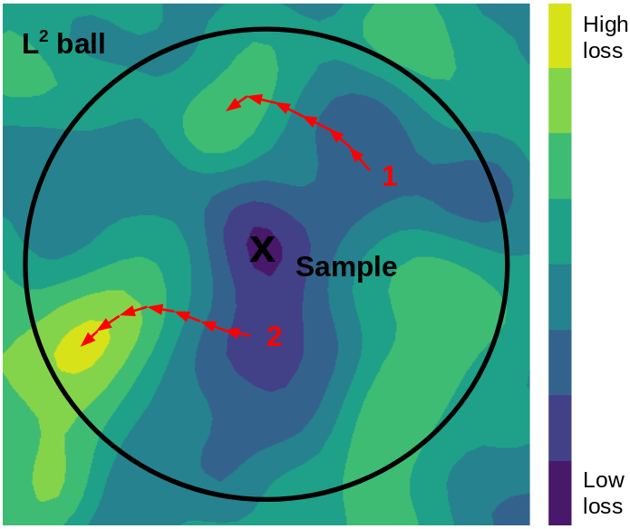
Attack Used
Projected gradient descent attack
Method:
Take a gradient step in the direction of greatest loss
Project perturbation back into L^p ball if necessary
Repeat 2–3 for user specified number of steps
Parameters we used:
Epsilon = 0.1 (In line with benchmark Chris found for MNIST)
Number of steps/iterations = 20 (reason for choice on next slide)
Step size = 0.01
Possible expansion: starting the attack from a random perturbation within the L^p ball like the visual on the right.
2-D visual where the starting point is a random place within L^p ball. Our method currently would start at the “x” in this visual and not 1 or 2:
Notes:
source:https://towardsdatascience.com/know-your-enemy-7f7c5038bdf3

Slide 8
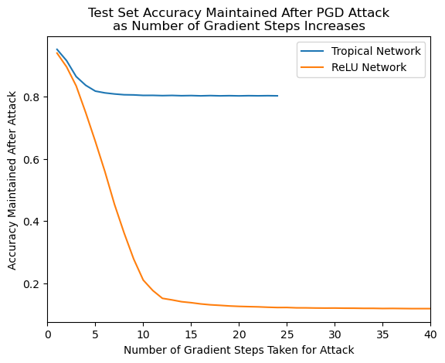
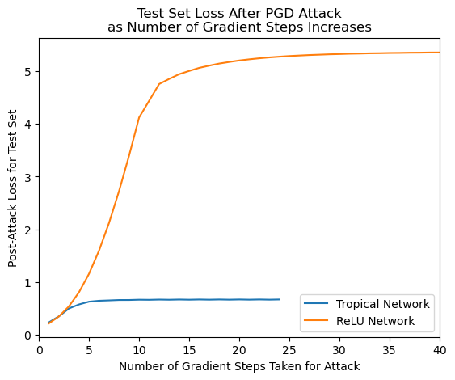
Choosing PGD Steps
Testing on a single ReLU model and Tropical model yields that 20 steps will get very near maximizing the loss for both models. We can maximize the loss in the tropical model with fewer steps, but to ensure an equal experiment setup, 20 was chosen for both.

Slide 9
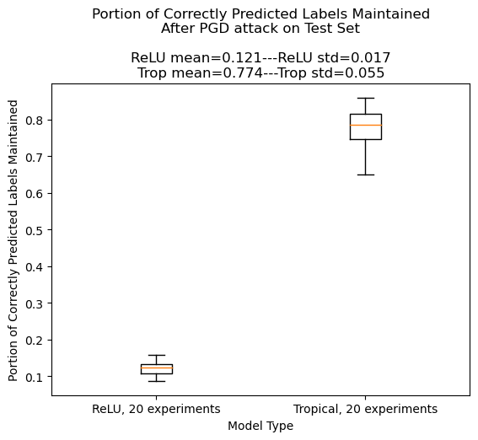
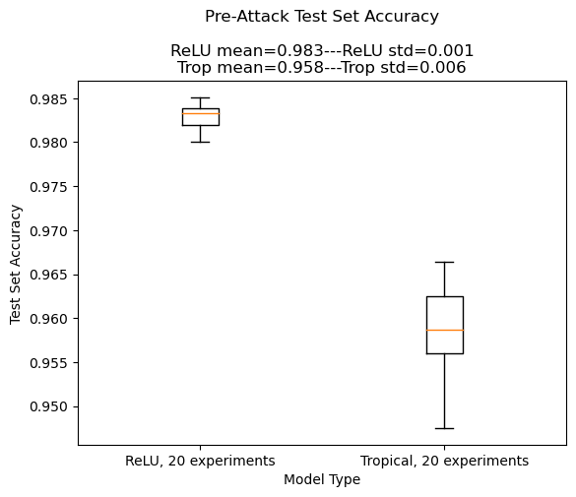
Results
ROBUSTNESS: Box plot of the level of classification degradation by the PGD attack on the 2 models… Tropical more robust by a lot!
ACCURACY: Pre-Attack accuracy on the test set. We clearly lose some predictive power with our Tropical layer as implemented

Slide 10
Some Possible Changes
Training Parameters: Since we are only training 2 weights at a time, I think the training methods used for tropical network might be able to be tuned differently than other networks. It seems like the number of epochs or the step value the weights are updated could be adjusted up. There might be other ways I am not aware of, but perhaps the right changes could improve the prediction power of the Tropical layer as is.

Slide 11
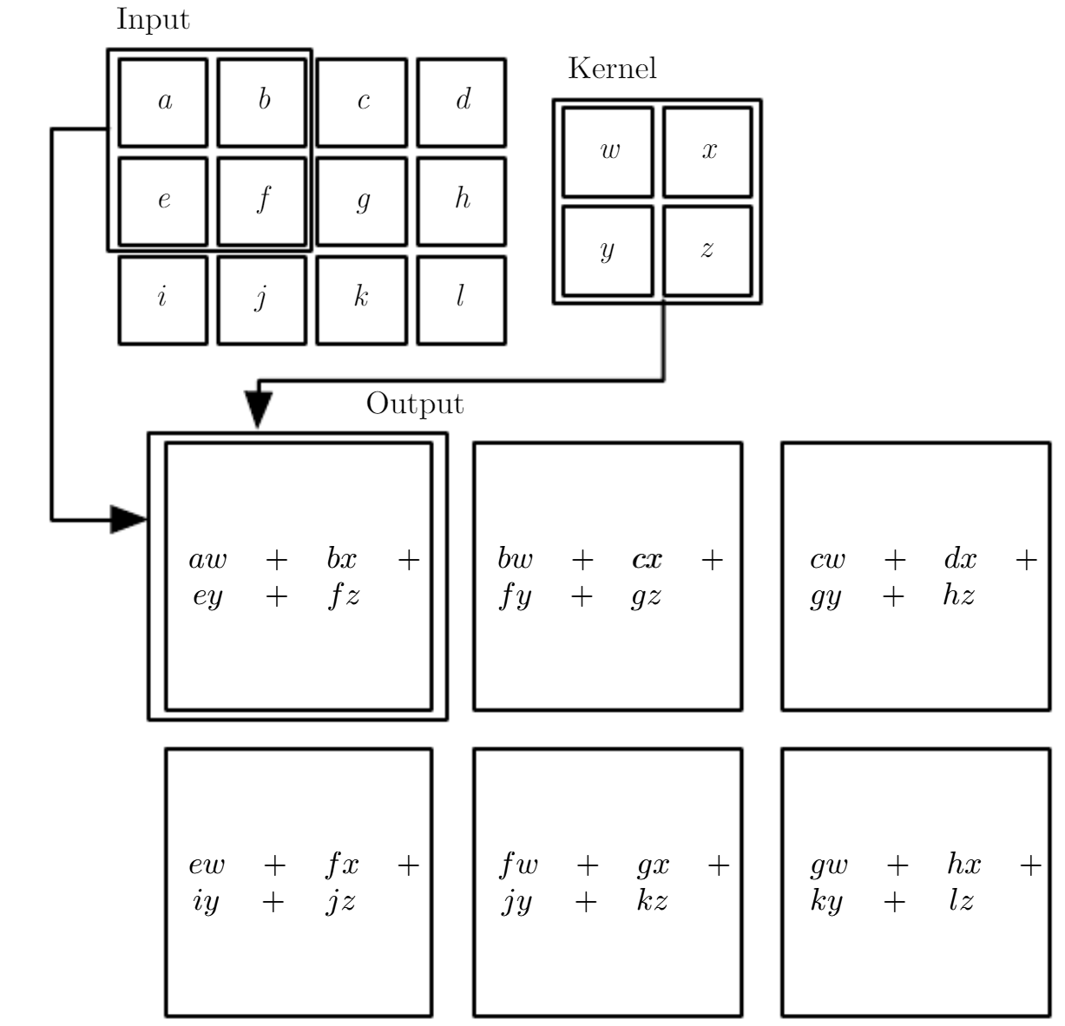
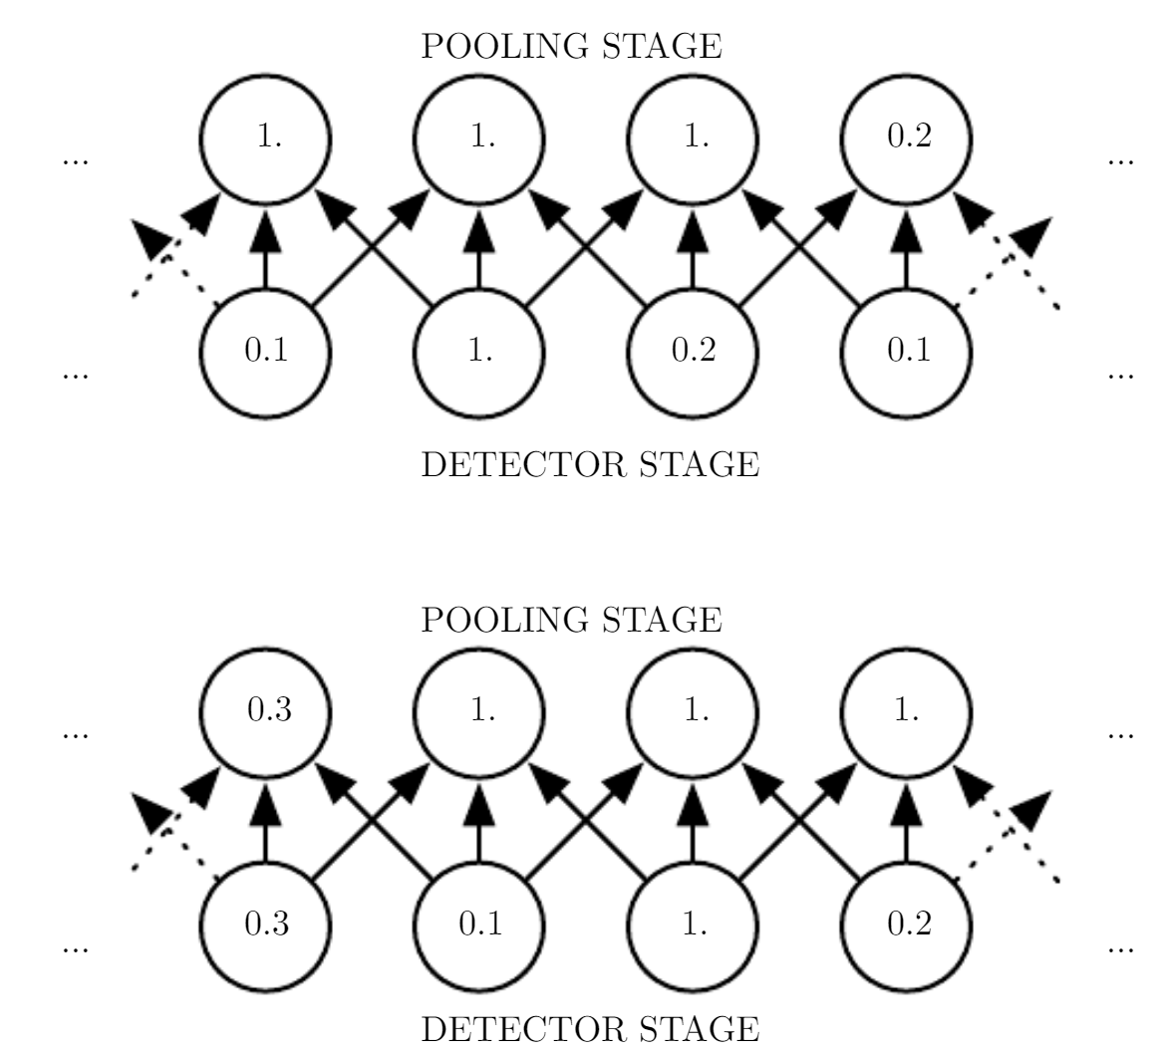
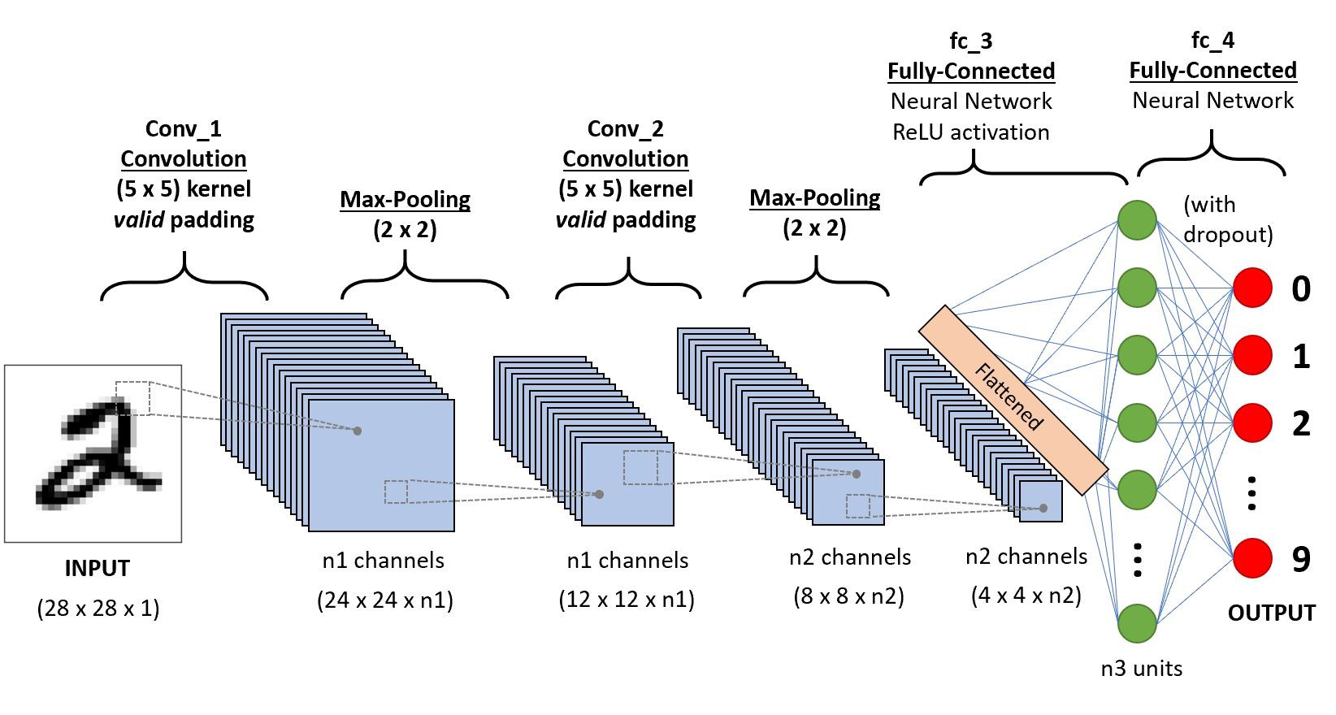
Some CNN Definitions
ChatGPT generated explanations of some key terms often used to describe parts of convolutional neural networks:
1. Filter (or Kernel):
- A small matrix applied to the input data during convolution.
- Captures specific patterns or features, such as edges, textures, or shapes.
2. Stride:
- A hyperparameter that defines the step size when moving the filter over the input data during convolution.
- A larger stride results in a smaller output volume.
3. Padding:
- The addition of zeros around the input data to control the output size.
- Two common types: "valid" (no padding) and "same" (padding to match input and output dimensions).
4. Pooling Layer:
- Used for down sampling the spatial dimensions of the data.
- Common types include max pooling and average pooling.
- Helps reduce computational complexity and overfitting.
5. Feature Map:
- The result of applying filters to the input data in a convolutional layer.
- Each feature map represents the presence of a specific feature or pattern.
6. Channels:
- The depth of the present data.
- For an RGB input image there are 3 channels.
- For the output of a convolutional layer there are “n” number of channels where n is the number of the filters/kernels specified by user.

